Slide 1



ANNOUNCEMENTS
Register on Piazza: piazza.com/umd/spring2022/cmsc320/home
236 have registered already
134 still to register
If you were on Piazza, you’d know …
Project 0 is out! It is “due” next Tuesday evening.
Link: https://github.com/cmsc320/spring2021/tree/main/project0
We’ve also linked some reading for the week!
First quiz is due Friday at 11:59pm
Unlimited time, only need to complete 10

Slide 2
(A FEW) DATA SCIENCE SUCCESS STORIES & CAUTIONARY TALES

Slide 3
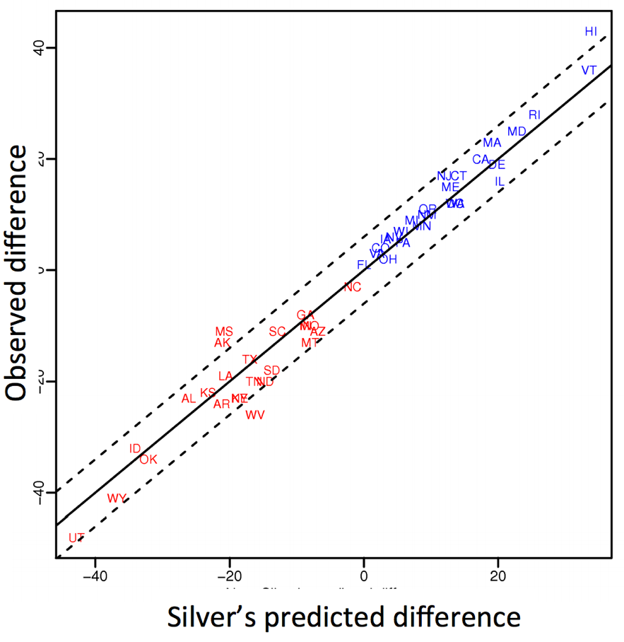
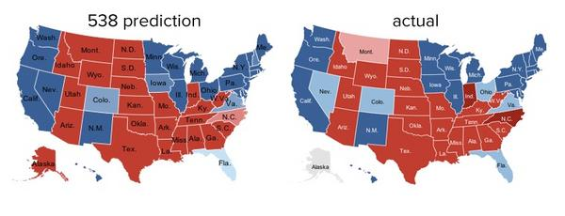
POLLING: 2008 & 2012
Nate Silver uses a simple idea – taking a principled approach to aggregating polling instead of relying on punditry – and:
Predicts 49/50 states in 2008
Predicts 50/50 states in 2012
(He is also a great case study in creating a brand.)
https://hbr.org/2012/11/how-nate-silver-won-the-2012-p
Democrat (+) or Republican (-) in 2012

Slide 4
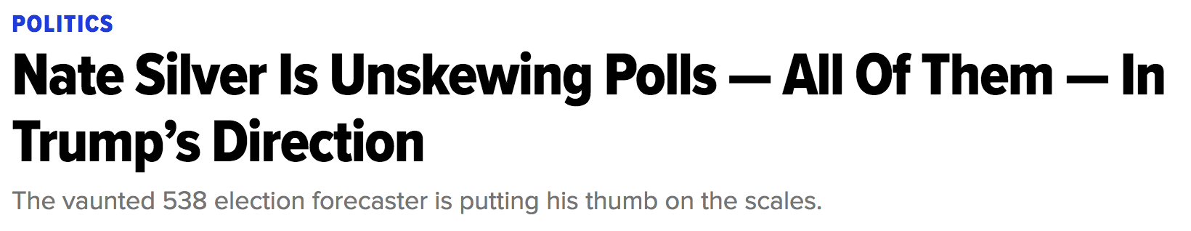
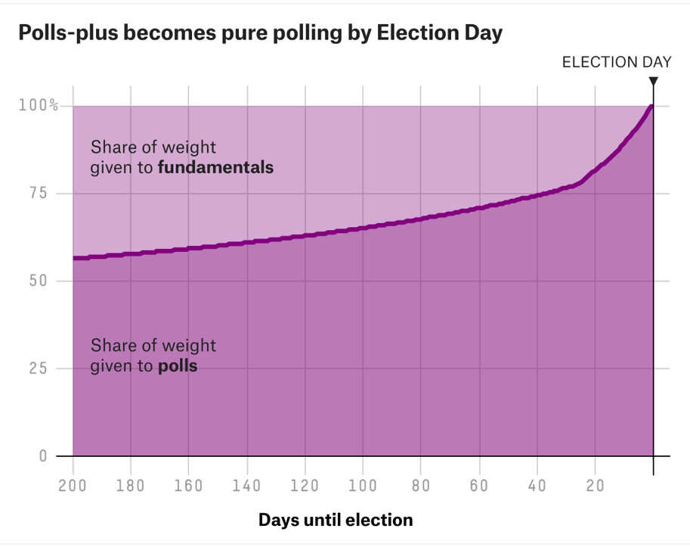
POLLING: 2016
HuffPo: “He may end up being right, but he’s just guessing. A “trend line adjustment” is merely political punditry dressed up as sophisticated mathematical modeling.”
538: Offers quantitative reasoning for re-/under-weighting older polls, & changing as election approaches
http://www.huffingtonpost.com/entry/nate-silver-election-forecast_us_581e1c33e4b0d9ce6fbc6f7f
https://fivethirtyeight.com/features/a-users-guide-to-fivethirtyeights-2016-general-election-forecast/

Slide 5
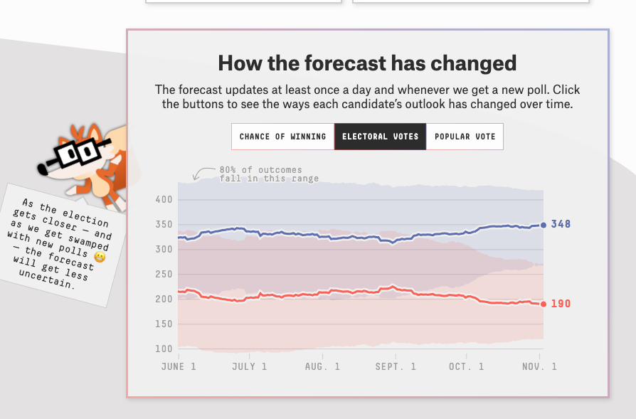
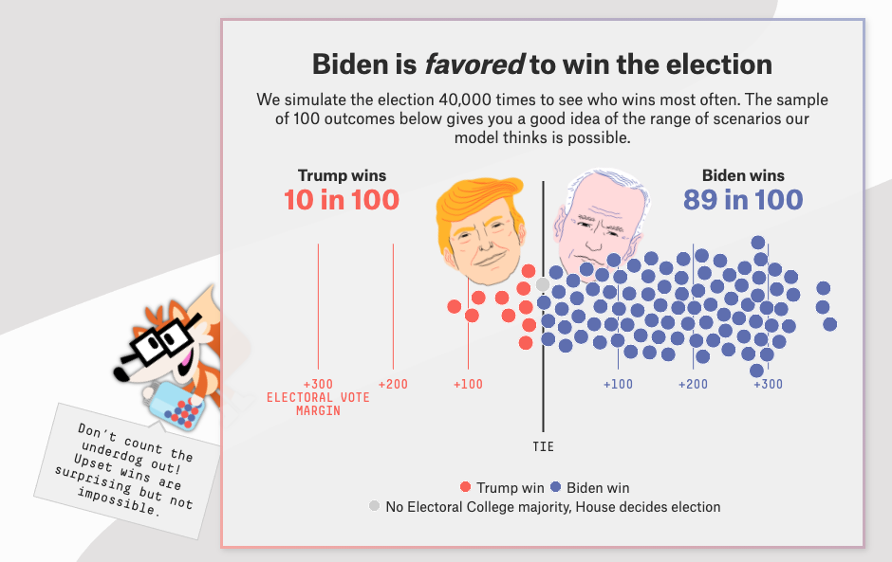
POLLING: 2020
Lessons learned: don’t just communicate a binary prediction (X loses, Y wins):
Communicate uncertainty over that prediction
Communicate variance in the underlying model(s), modeling errors, etc

Slide 6

AD TARGETING
Pregnancy is an expensive & habit-forming time
Thus, valuable to consumer-facing firms
2012:
Target identifies 25 products and subsets thereof that are commonly bought in early pregnancy
Uses purchase history of patrons to predict pregnancy, targets advertising for post-natal products (cribs, etc)
Good: increased revenue
Bad: this can expose pregnancies – as famously happened in Minneapolis to a high schooler
http://www.businessinsider.com/the-incredible-story-of-how-target-exposed-a-teen-girls-pregnancy-2012-2

Slide 7




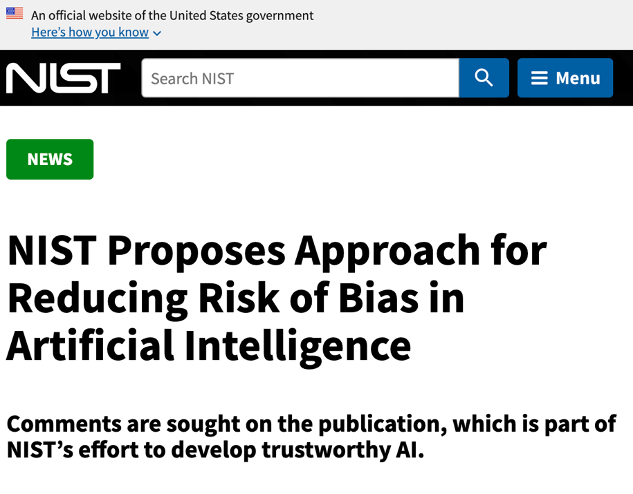





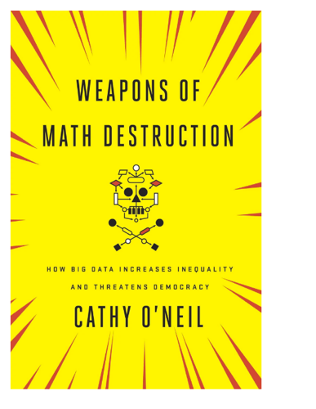
AUTOMATED DECISIONS OF CONSEQUENCE
[Sweeney 2013, Miller 2015, Byrnes 2016,
Rudin 2013, Barry-Jester et al. 2015]
Policing/
sentencing
Hiring
Lending
Search for minority names 🡪
ads for DUI/arrest records
Female cookies 🡪
less freq. shown professional job opening ads

Slide 8

“… a lot remains unknown about how big data-driven decisions may or may not use factors that are proxies for race, sex, or other traits that U.S. laws generally prohibit from being used in a wide range of commercial decisions … What can be done to make sure these products and services–and the companies that use them treat consumers fairly and ethically?”
- FTC Commissioner Julie Brill [2015]
“Hold yourself accountable – or be ready for the FTC to do it for you. As we’ve noted, it’s important to hold yourself accountable for your algorithm’s performance. … keep in mind that if you don’t hold yourself accountable, the FTC may do it for you.”
- FTC official blog post, “Aiming for truth, fairness, and equity in your company’s use of AI”, written by Elisa Jillson [2021]

Slide 9
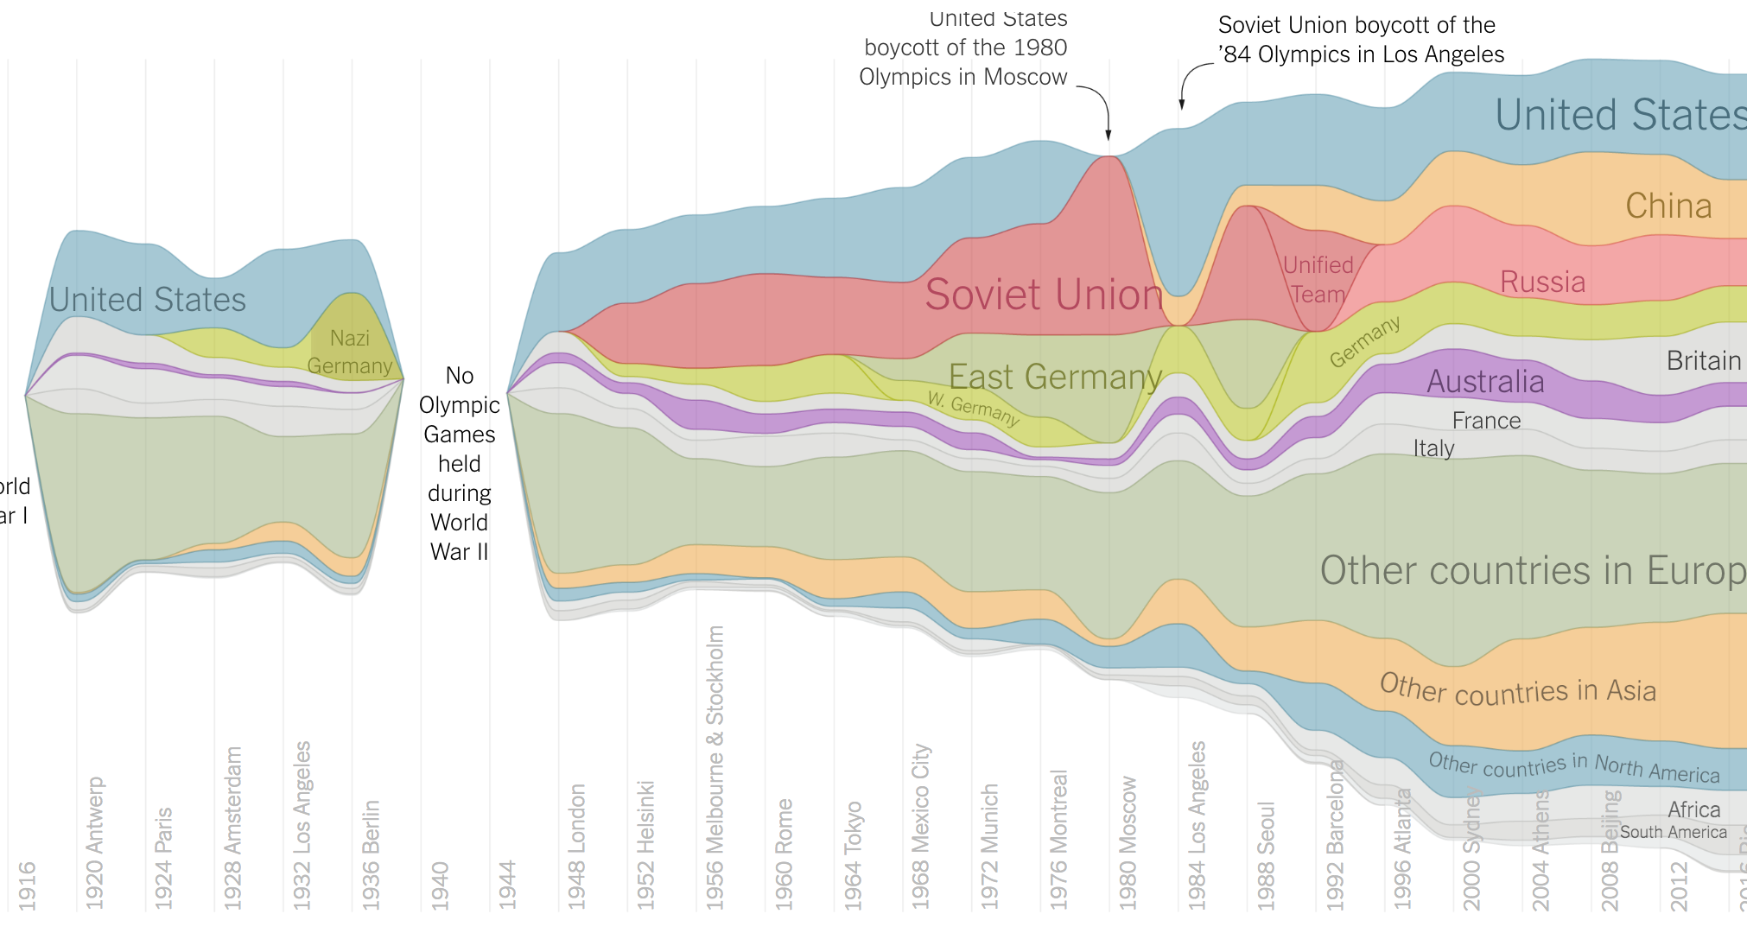
OLYMPIC MEDALS
https://www.nytimes.com/interactive/2016/08/08/sports/olympics/history-olympic-dominance-charts.html

Slide 10

NETFLIX PRIZE I
Recommender systems: predict a user’s rating of an item
Netflix Prize: $1MM to the first team that beats our in-house engine by 10%
Happened after about three years
Model was never used by Netflix for a variety of reasons
Out of date (DVDs vs streaming)
Too complicated / not interpretable
 | Twilight | Wall-E | Twilight II | Furious 7
User 1 | +1 | -1 | +1 | ?
User 2 | +1 | -1 | ? | ?
User 3 | -1 | +1 | -1 | +1

Slide 11
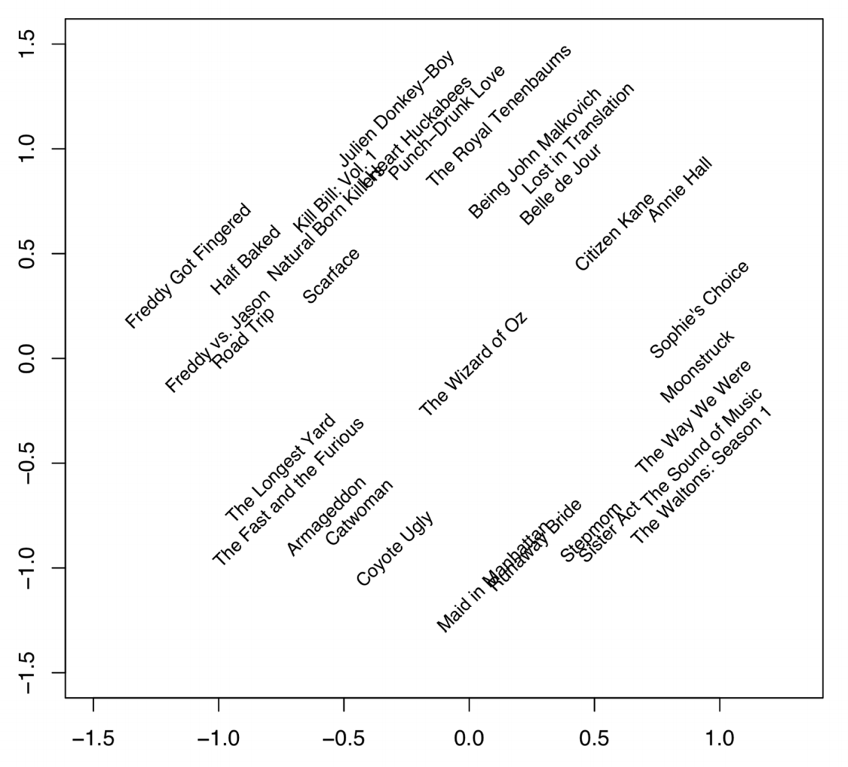
NETFLIX PRIZE II
Frat/Gross-Out Comedy
Critically-Acclaimed/Strong Female Lead
Artsy
Latent factors model:
Identify factors with max discrimination between movies
Latent factor 1
BB
Latent factor 2
Image courtesy of Christopher Volinsky

Slide 12
NETFLIX PRIZE III
Netflix initially planned a follow-up competition
In 2007, UT Austin managed to deanonymize portions of the original released (anonymized) Netflix dataset:
????????????
Matched rating against those made publicly on IMDb
Why could this be bad?
2009—2010, four Netflix users filed a class-action lawsuit against Netflix over

Slide 13
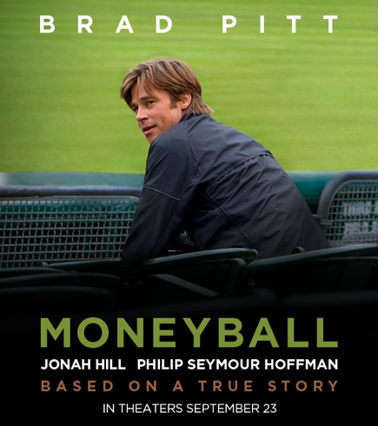
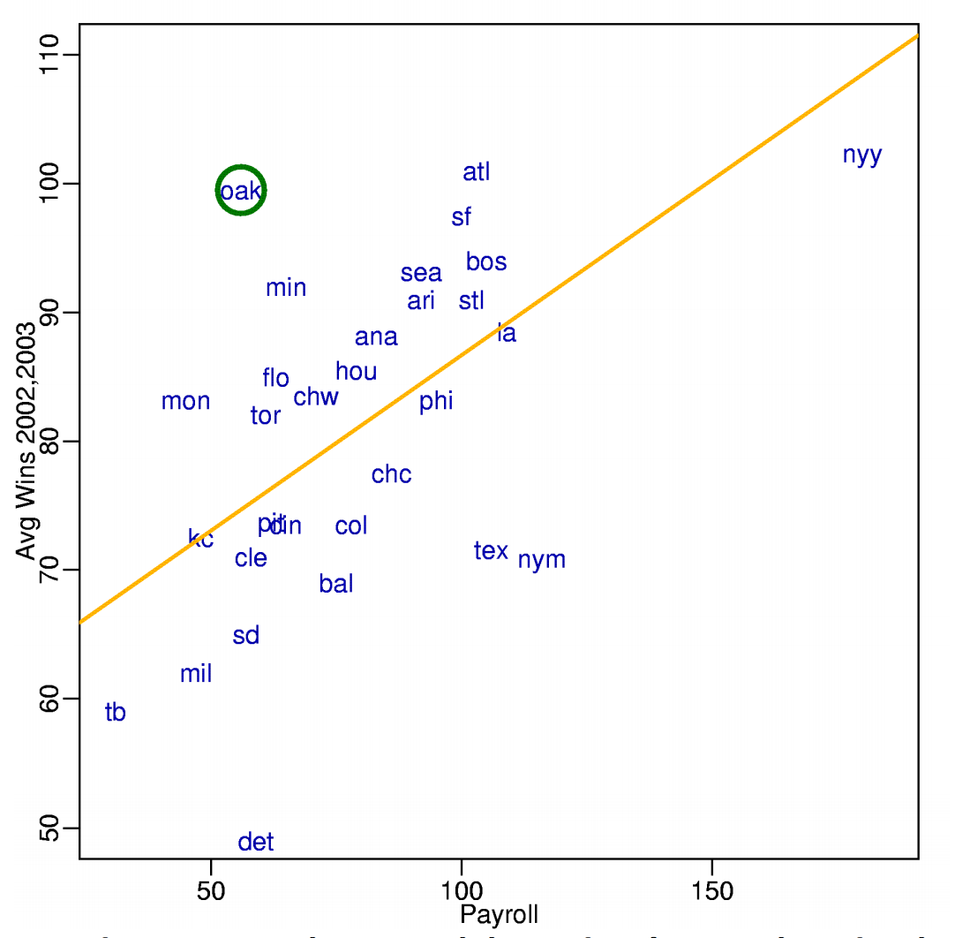
MONEYBALL
Baseball teams drafted rookie players primarily based on human scouts’ opinions of their talents
Paul DePodesta, data scientist du jour, convinces the {bad, poor} Oakland Athletics to use a quantitative aka sabermetric approach to hiring
(Spoiler: Red Sox offer Brand a job, he says no, they take a sabermetric approach and win the World Series.)
(Spoiler #2: DePodesta is now Chief Strategy Officer for the Browns, and they extended his contract in 2021, so we’ll see what happens!)
Notes:
“Sabermetrics” = “SABR” = “Society for American Baseball Research”
Peter Brand = name of character in the movie, actual name is Paul DePodesta

Slide 14
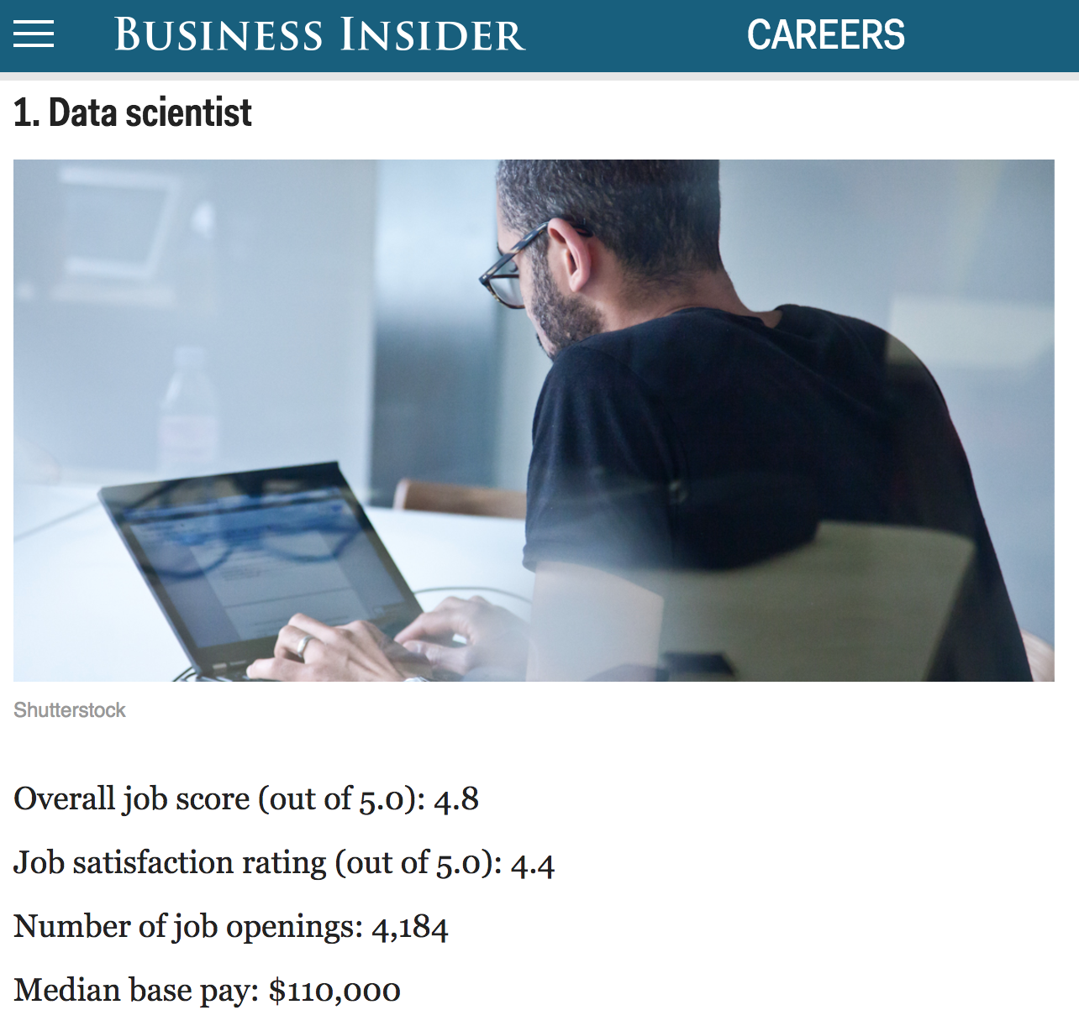
http://www.businessinsider.com/best-jobs-in-america-in-2017-2017-1/

Slide 15


NEXT (AKA THE REST OF THIS) CLASS: SCRAPING DATA WITH PYTHON

Slide 16
THE DATA LIFECYCLE
Data collection
Data processing
Exploratory analysis
&
Data viz
Analysis, hypothesis testing, & ML
Insight & Policy Decision

Slide 17
(THE REST OF) TODAY’S LECTURE
Data collection
Data processing
Exploratory analysis
&
Data viz
Analysis, hypothesis testing, & ML
Insight & Policy Decision

Slide 18
BUT FIRST, SNAKES!
Python is an interpreted, dynamically-typed, high-level, garbage-collected, object-oriented-functional-imperative, and widely used scripting language.
Interpreted: instructions executed without being compiled into (virtual) machine instructions*
Dynamically-typed: verifies type safety at runtime
High-level: abstracted away from the raw metal and kernel
Garbage-collected: memory management is automated
OOFI: you can do bits of OO, F, and I programming
Not the point of this class!
Python is fast (developer time), intuitive, and used in industry!
*you can compile Python source, but it’s not required

Slide 19

THE ZEN OF PYTHON
Beautiful is better than ugly.
Explicit is better than implicit.
Simple is better than complex.
Complex is better than complicated.
Flat is better than nested.
Sparse is better than dense.
Readability counts.
Special cases aren't special enough to break the rules …
… although practicality beats purity.
Errors should never pass silently …
… unless explicitly silenced.
Thanks: SDSMT ACM/LUG

Slide 20


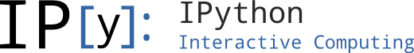
LITERATE PROGRAMMING
Literate code contains in one document:
the source code;
text explanation of the code; and
the end result of running the code.
Basic idea: present code in the order that logic and flow of human thoughts demand, not the machine-needed ordering
Necessary for data science!
Many choices made need textual explanation, ditto results.
Stuff you’ll be using in Project 0 (and beyond)!

Slide 21
JUPYTER PROJECT
Started as iPython Notebooks, a web-based frontend to the iPython Shell
The “notebook” functionality separated out years ago
Now supports over 40 languages/kernels
Notebooks can be shared easily
Can leverage big data tools like Spark
Apache Zeppelin:
https://www.linkedin.com/pulse/comprehensive-comparison-jupyter-vs-zeppelin-hoc-q-phan-mba-
Several others, e.g., RStudio (specific to R) – can run R via Jupyter, too (IMO, worse!)

Slide 22
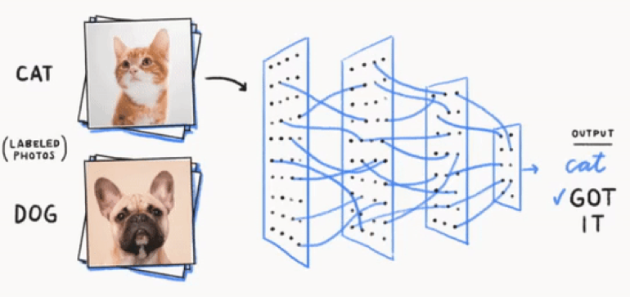

GOOGLE COLAB
Recall: Jupyter Notebooks are web-based frontends that let you execute arbitrary Python in your browser
What if you want to run some heavy computation (e.g., train a deep net from scratch, or even just do inference on a pre-trained net)?
Google Colab(oratory) lets you use Google’s GPUs and TPUs to do heavy lifting, generally for free
Notebooks hosted on Google Drive or Github
Share them with other people with no install needed
Here’s an example CMSC320 tutorial from Fall 2020 that is available on Colab: https://colab.research.google.com/drive/1co_-qwtCmwl_0hCU5Vrz0Lcnp-Qvy_4_
You’ll see and use this, and similar cloud services, in ML / data science land.

Slide 23
10-MINUTE PYTHON PRIMER
Define a function:
Python is whitespace-delimited
Define a function that returns a tuple:
def my_func(x, y):
if x > y:
return x
else:
return y
def interview(n):
if n % 3 == 0 and n % 5 == 0:
return 'FizzBuzz'
elif n % 3 == 0:
return 'Fizz'
elif n % 5 == 0:
return 'Buzz'
else:
return str(n)
print( "\n".join(interview(n) for n in xrange(1, 101)) )
def my_func(x, y):
return (x-1, y+2)
(a, b) = my_func(1, 2)
a = 0; b = 4

Slide 24
USEFUL BUILT-IN FUNCTIONS: COUNTING AND ITERATING
len: returns the number of items of an enumerable object
range: returns an iterable object
enumerate: returns iterable tuple (index, element) of a list
https://docs.python.org/3/library/functions.html
len( [‘c’, ‘m’, ‘s’, ‘c’, 3, 2, 0] )
7
list( range(10) )
[0, 1, 2, 3, 4, 5, 6, 7, 8, 9]
enumerate( [“311”, “320”, “330”] )
[(0, “311”), (1, “320”), (2, “330”)]
Notes:
do demo

Slide 25
USEFUL BUILT-IN FUNCTIONS: MAP AND FILTER
map: apply a function to a sequence or iterable
filter: returns a list* of elements for which a predicate is true
We’ll go over in much greater depth with pandas/numpy.
arr = [1, 2, 3, 4, 5]
map(lambda x: x**2, arr)
[1, 4, 9, 16, 25]
arr = [1, 2, 3, 4, 5, 6, 7]
filter(lambda x: x % 2 == 0, arr)
[2, 4, 6]
*in Python 3, returns Iterable
Notes:
Note that filter(function, iterable) is equivalent to the generator expression (item for item in iterable if function(item)) if function is not None and (item for item in iterable if item) if function is None.

Slide 26
PYTHONIC PROGRAMMING
Basic iteration over an array in Java:
Direct translation into Python:
A more “Pythonic” way of iterating:
int[] arr = new int[10];
for(int idx=0; idx<arr.length; ++idx) {
System.out.println( arr[idx] );
}
idx = 0
while idx < len(arr):
print( arr[idx] ); idx += 1
for element in arr:
print( element )

Slide 27

LIST COMPREHENSIONS
Construct sets like a mathematician!
P = { 1, 2, 4, 8, 16, …, 2¹⁶ }
E = { x | x in ℕ and x is odd and x < 1000 }
Construct lists like a mathematician who codes!
Very similar to map, but:
You’ll see these way more than map in the wild
Many people consider map/filter not “pythonic”
They can perform differently (map is “lazier”)
P = [ 2**x for x in range(17) ]
E = [ x for x in range(1000) if x % 2 != 0 ]

Slide 28
EXCEPTIONS
Syntactically correct statement throws an exception:
tweepy (Python Twitter API) returns “Rate limit exceeded”
sqlite (a file-based database) returns IntegrityError
print('Python', python_version())
try:
cause_a_NameError
except NameError as err:
print(err, '-> some extra text')

Slide 29
PYTHON 2 VS 3
Python 3 is intentionally backwards incompatible
(But not that incompatible)
Biggest changes that matter for us:
print “statement” 🡪 print(“function”)
1/2 = 0 🡪 1/2 = 0.5 and 1//2 = 0
ASCII str default 🡪 default Unicode
Namespace ambiguity fixed:
i = 1
[i for i in range(5)]
print(i) # ????????
Python 2: prints “4”; Python 3: prints “1” (narrow scope)
Notes:
Prints “4” in Python 2 and “1” (i.e., unchanged because the list comprehension scope is dead) in Python 3.

Slide 30
TO ANY CURMUDGEONS …
If you’re going to use Python 2 anyway, use the _future_ module:
Python 3 introduces features that will throw runtime errors in Python 2 (e.g., with statements)
_future_ module incrementally brings 3 functionality into 2
https://docs.python.org/2/library/__future__.html
from _future_ import division
from _future_ import print_function
from _future_ import please_just_use_python_3

Slide 31
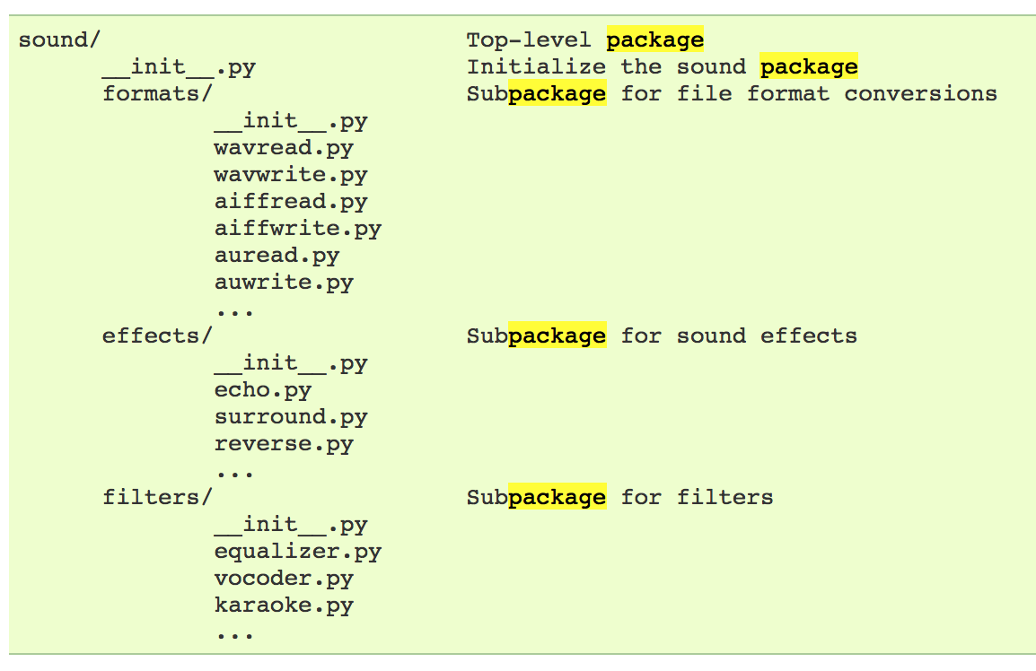
SO, HOW DOES IMPORT WORK?
Python code is stored in module – simply put, a file full of Python code
A package is a directory (tree) full of modules that also contains a file called __init.py__
Packages let you structure Python’s module namespace
E.g., X.Y is a submodule Y in a package named X
For one module to gain access to code in another module, it must import it
# Load (sub)module sound.effects.echo
import sound.effects.echo
# Must use full name to reference echo functions
sound.effects.echo.echofilter(input, output, delay=0.7)
https://docs.python.org/2/tutorial/modules.html

Slide 32
EXAMPLE
# Load (sub)module sound.effects.echo
import sound.effects.echo
# Must use full name to reference echo functions
sound.effects.echo.echofilter(input, output, delay=0.7)
# Load (sub)module sound.effects.echo
from sound.effects import echo
# No longer need the package prefix for functions in echo
echo.echofilter(input, output, delay=0.7)
# Load a specific function directly
from sound.effects.echo import echofilter
# Can now use that function with no prefix
echofilter(input, output, delay=0.7)
https://docs.python.org/2/tutorial/modules.html

Slide 33
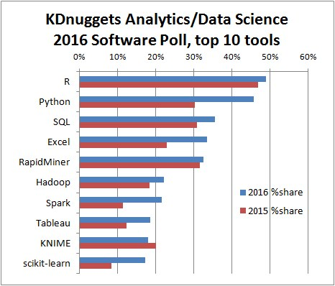
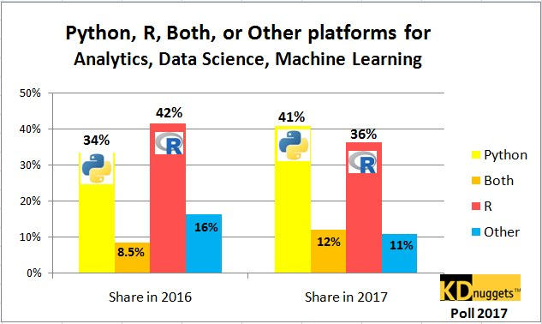
PYTHON VS R (FOR DATA SCIENTISTS)
There is no right answer here!
Python is a “full” programming language – easier to integrate with systems in the field
R has a more mature set of pure stats libraries …
… but Python is catching up quickly …
… and is already ahead specifically for ML.
You will see Python more in the tech industry.
https://insights.stackoverflow.com/survey/2021

Slide 34
EXTRA RESOURCES
Plenty of tutorials on the web:
https://www.learnpython.org/
Work through Project 0, which will take you through some baby steps with Python and the Pandas library:
(We’ll also post some more readings soon.)
Come (virtually!) hang out at office hours:
All office hours will be on the website/Piazza by early next week.
Will have coverage MTWThF.

